Slide 1
Welcome to N-7
Please take a moment to…
Take a look around
Find your child’s desk
Read the note they left for you- inside their GEAR folder!
Write a note to your son/daughter on the heart and leave in desk
Please take with you …
GEAR folder
Mrs. Amy Michener

Slide 2
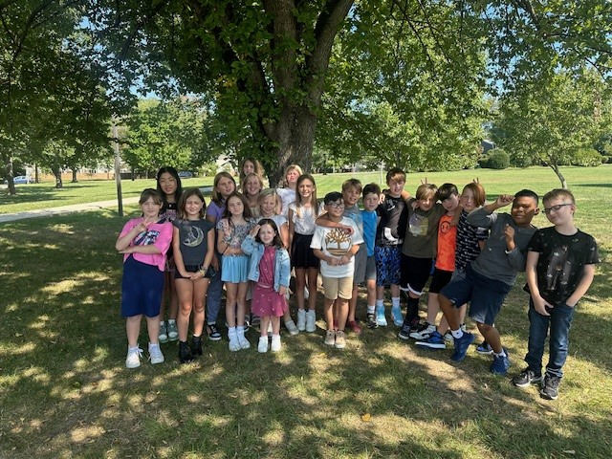
Michener Explorers
Class Picture Goes in this Section
2024 - 2025

Slide 3
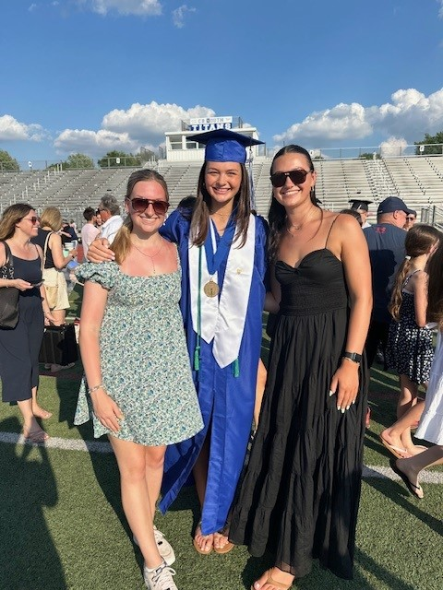
Mrs. Michener
Twin 19 year-old daughters, Emma and Lauren
18 year-old daughter, Abby.

Slide 4
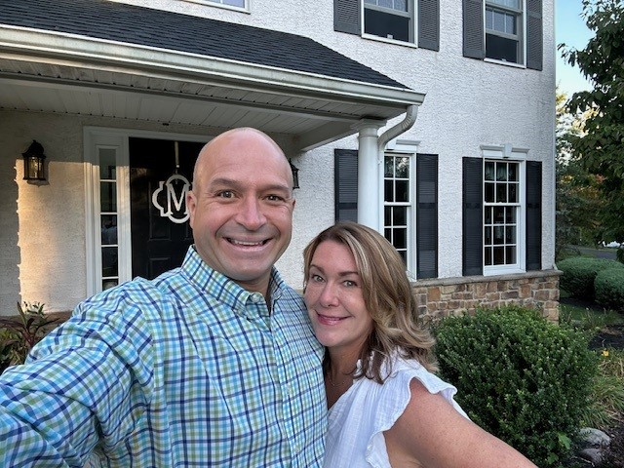
Mrs. Michener
Dave – 6th grade teacher at Titus and Race Director/Owner of Steelman Racing.

Slide 5
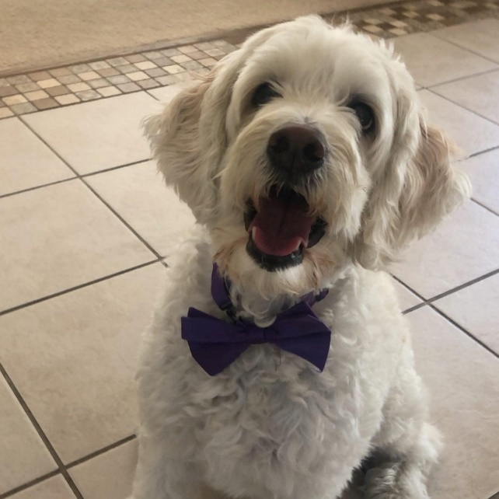
Mrs. Michener
And we can’t forget about …… Max!

Slide 6
Mrs. Michener
Education:
Bachelor’s degree from Holy Family College
Master’s degree from LaSalle University
Certifications in Special and Elementary Education
30th year teaching:
27 years in Central Bucks
22 years at Doyle

Slide 7
Assistant Principal – Ms. Jacobson
Laptops
FID – bags to go home tonight
Reflex math
Letter Grades
String Instrument Lessons
Text Dependent Analysis
Homeroom parent
What’s New?

Slide 8

FID

Slide 9
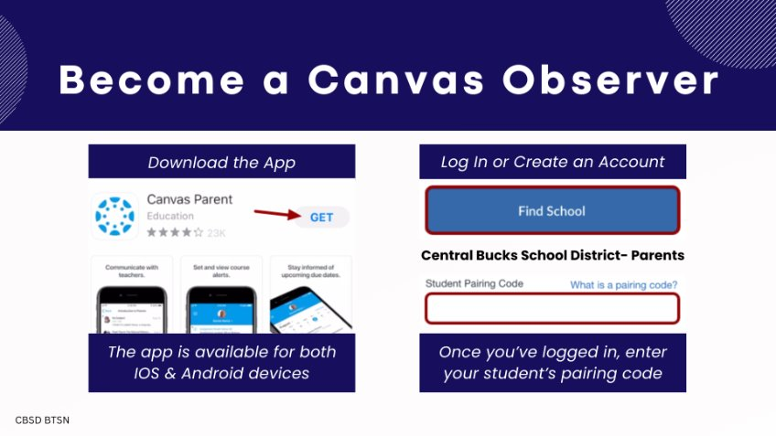
Become a Canvas Observer

Slide 10
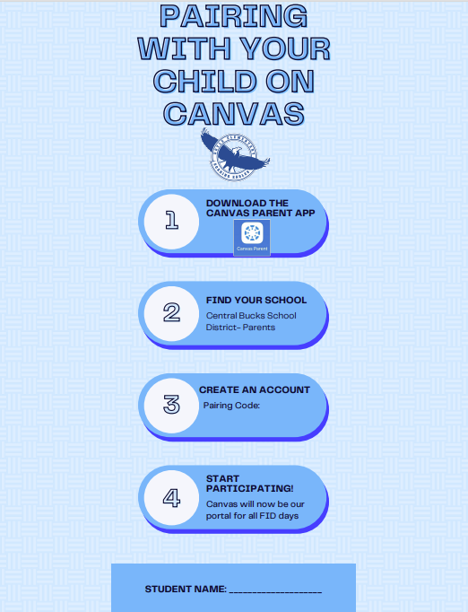
Only one code per household
If you need an additional
Code for a second household
please reach out next week
Can pair tonight- the code is
Good for the next six days.
Canvas Pairing

Slide 11
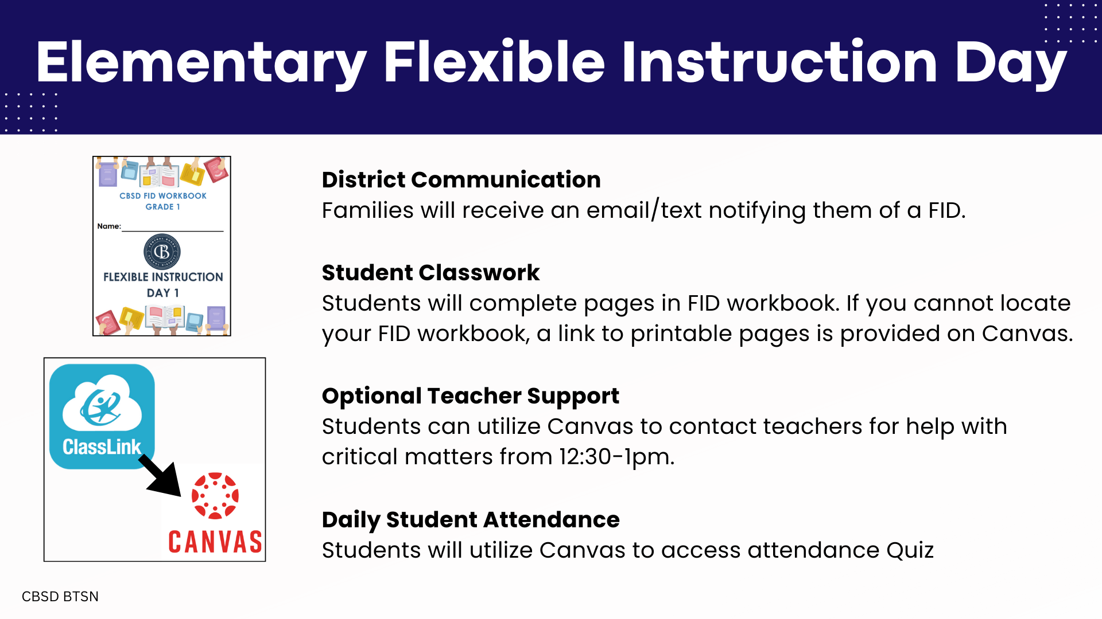
FID

Slide 12
Schedule
8:40 – 8:55 – Class Meeting
9:00 – 9:40 -Specials
9:40 – 10:50 – Math
10:50 – 11:30 – Snack/Reading (Part 1)
11:30 – 12:00 – WIN
12:00 – 12:40 - Writing
12:40 – 1:40 – Recess/Lunch
1:40 – 2:25 – Reading (Part 2)
2:25 – 3:05 – Social Studies/Science
3:05 – 3:10 – Closing Circle

Slide 13
Morning Routine
Unpack
Prepare supplies for the day
Soft Start Activities
Announcements
Morning Meeting

Slide 14
Specials
Day 1 – Quest
Day 2 – Library
Day 3 – Music
Day 4 – Gym
Day 5 – Art

Slide 15
Math
Calendar Math
Basic skills such as place value, multiplication/division, area/perimeter, measuring angles, in/out function tables
Math in Focus
Focused approach in each unit
Differentiation during instruction
*Chapter Review

Slide 16
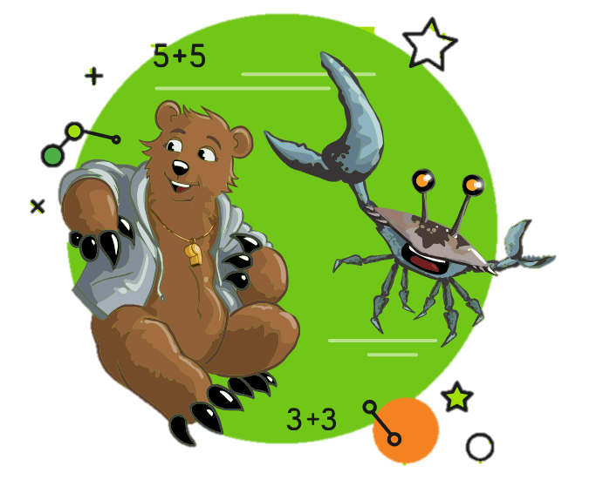
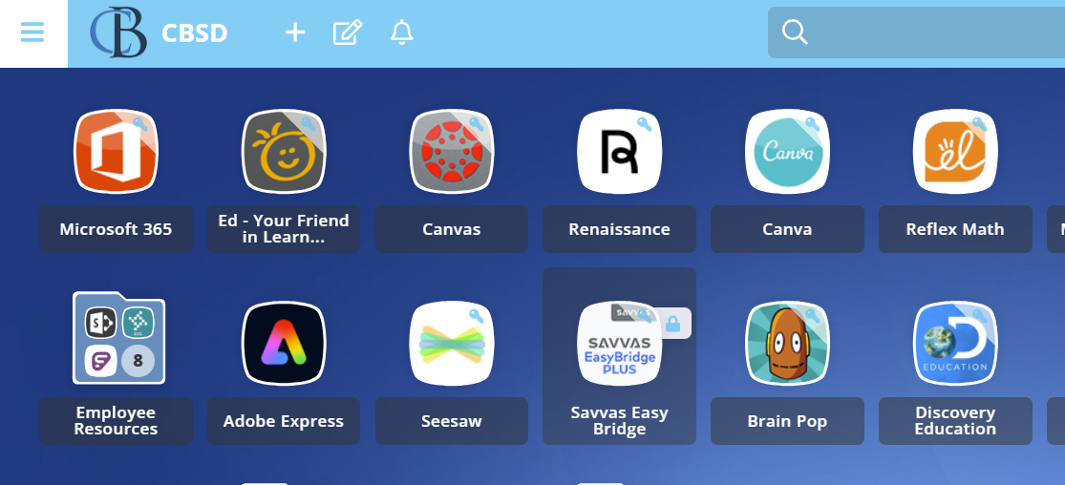
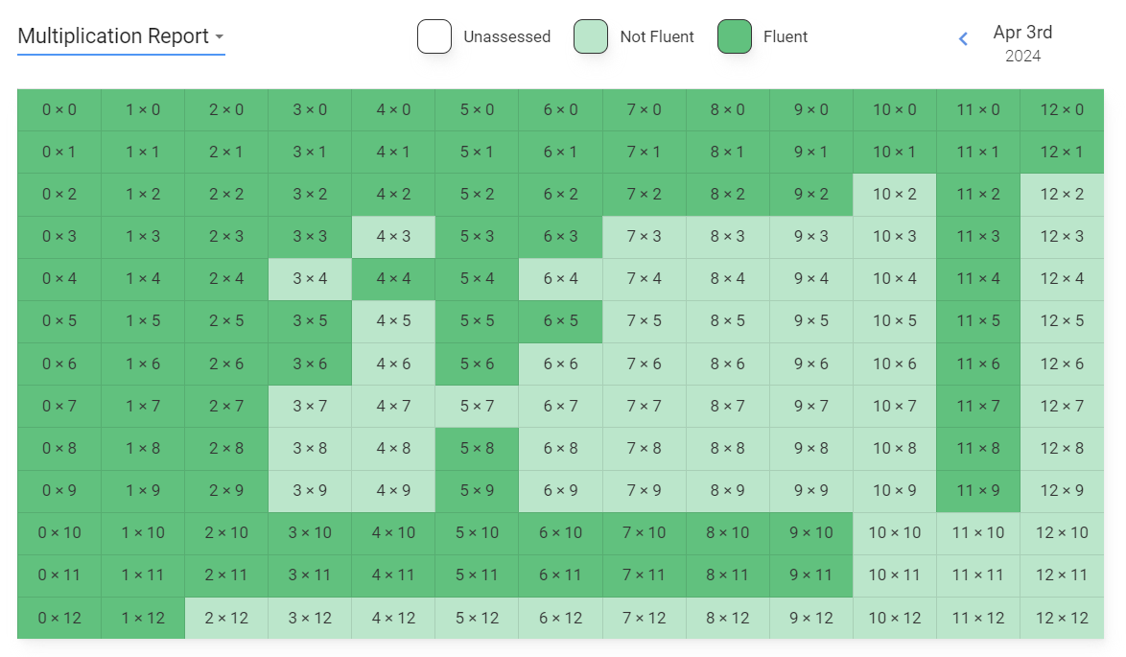
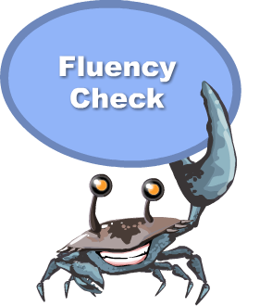



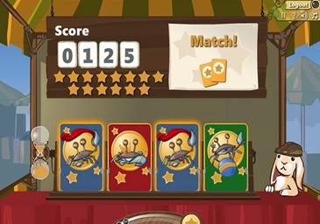
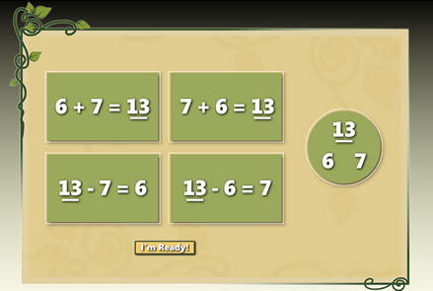
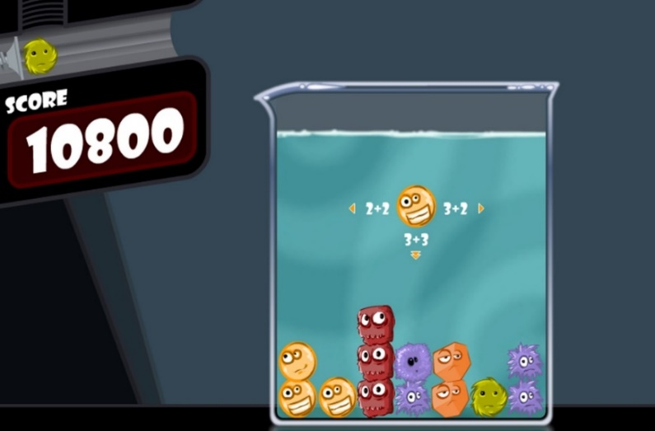
Reflex Math
Log in through ClassLink with any device.
+
+
Practice
=
Assessment
Notes:
1. Your child can log into Reflex Math using any device – laptop, iPad, cell phone, etc. Please use Classlink. If you have multiple children please make sure each child logs into their own Classlink account when the use Reflex Math.
2. Each session of Reflex Math contains a short assessment of math facts, a coaching (or learning) session, and a practice game session. Completing all of these parts will illuminate the green light in the top right corner. A session can take 15-20 minutes but can take longer in the beginning of the year. Sometimes we may begin a session in school and your child may finish at home.
If it is taking longer than 15-20 minutes for your child to complete a Reflex session they do not need to continue and can log out at any time. Any practice is good practice!
3. Reflex Math is one way we will be assessing fluency. We will share assessment data gathered from Reflex Math at our December conferences along with other paper/pencil assessments.

Slide 17
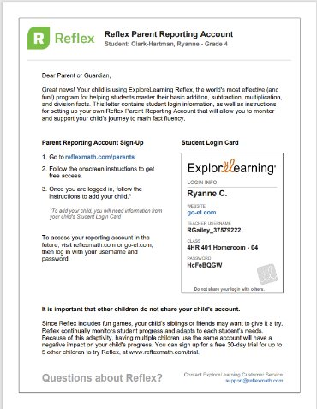
Reflex Math

Slide 18
Reading
My View
Text Dependent Analysis
Strategy Instruction including:
Summarizing, Connections, Visualizations,
Monitoring, Questioning, Predictions,
Inferences, Drawing Conclusions

Slide 19
Flexible Grouping
Enrichment as well as areas in need of
improvement
Team approach
W.I.N.
(What I Need)

Slide 20
Writing
  The Year of the Sentence
  In Conjunction with My View Reading Series/Mentor Texts to Model Writer’s Craft, Genres, and Grammar
  Writer’s Notebooks
  Writing Process – Brainstorming, Drafting, Revising, Editing
  and Publishing
  Author’s Chair for Students to Share Their Writing

Slide 21
Recess/Lunch
Dress according to weather
Try to get the children out as much as possible

Slide 22
Read Aloud
Students will return from recess/lunch
Throughout the year, students will listen to various books and discuss as a group.

Slide 23
Reading- Part 2
Independent/group activities- in response to whole group instruction
  Vocabulary
  Comprehension
  Application

Slide 24
Social Studies
Explore the regions of the United States
Northeast
Southeast
Midwest
Southwest
West

Slide 25
Science
Electrical Circuits
Matter
Watery earth

Slide 26
End of Day Routine
Copy homework & color in chart
Pack up
Will take home folder- please initial and return
Closing Circle
Notes:
Personal Narrative, informational travel brochure, how to, realistic fiction, opinion writing, poetry

Slide 27
Homework
20+ mins Reading
Math Page
Study math facts- flashcards, BINGO, worksheet, games, apps
Study for tests/quizzes- study guides

Slide 28
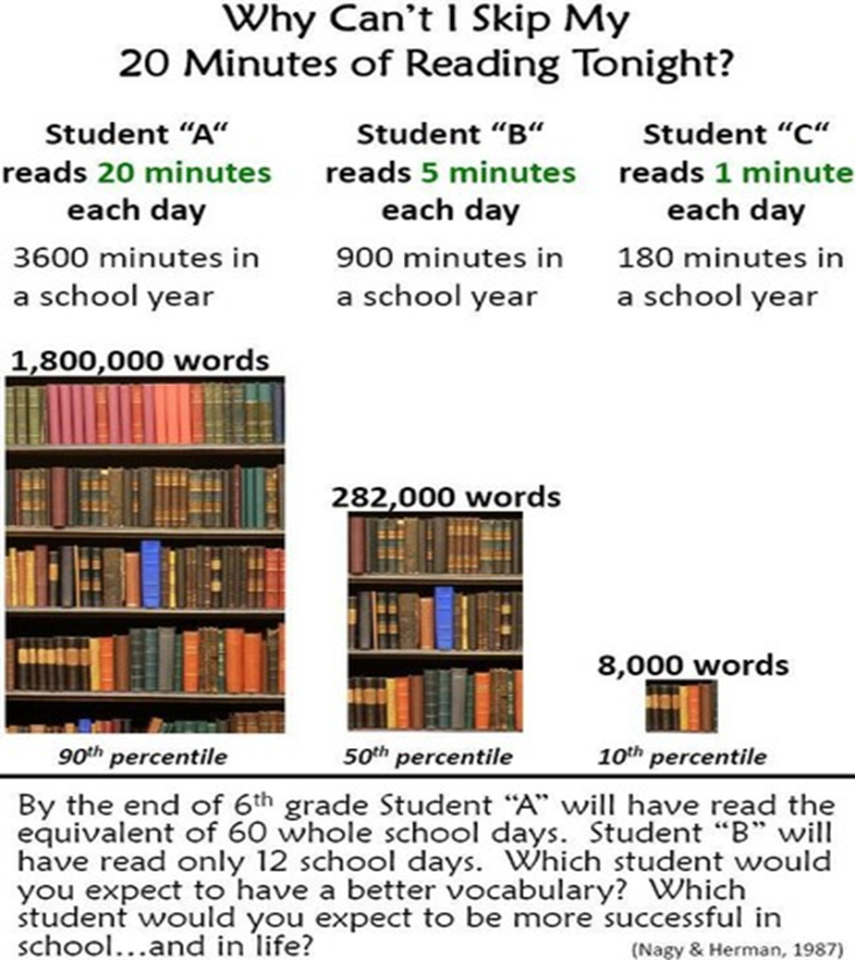
Reading Counts
Notes:
Personal Narrative, informational travel brochure, how to, realistic fiction, opinion writing, poetry

Slide 29
Dismissal
Car Riders first
Walkers
After care
Busses

Slide 30
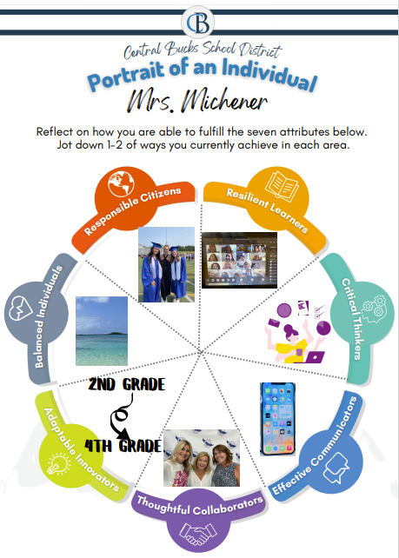
Portrait of a Graduate

Slide 31
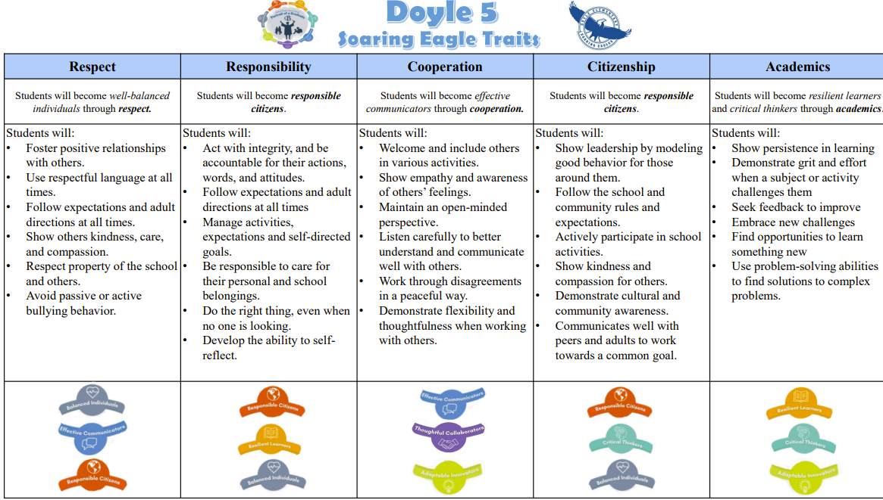
Doyle Five
Notes:
Personal Narrative, informational travel brochure, how to, realistic fiction, opinion writing, poetry

Slide 32
Classroom Management
Positive Reinforcement
Individual
  Michener Mulah
  Wing Tips – Soaring Eagle Assembly
  Behavior Chart- GREEN, YELLOW, BLUE, PURPLE, RED
Group – points
Class - Marble jar- reward party
Consequences
Conduct Report/ Behavior notice- Reflection session

Slide 33
Special Days
Nasa Day
Rock 4th Grade
Camping Day
Polar Express
Glow Games

Slide 34
Explorer of the Week
Monday- Share poster and answer questions from classmates
Tuesday- Lunch date with Mrs. Michener and two friends
Wednesday- Share a favorite story or poem with the class
Thursday- Bring in and share mementos/photos/etc with the class
Friday- choose our winners for
Michener Mulah!

Slide 35
Field Trips
Pennsbury Manor
Art Trip – Michener Museum and possibly Mercer too

Slide 36
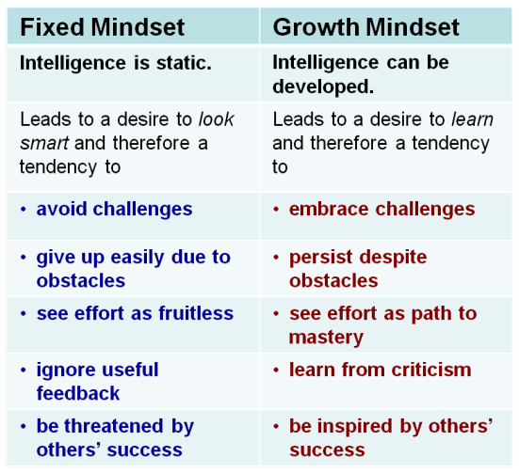
Growth Mindset

Slide 37
Communication
Communication + Collaboration = Success
almichener@cbsd.org
Teacher sites
Folders sent home daily
Notes in homework planner
Weekly emails
Seesaw
267-893-4300 x 1443
Cell- 267-784-9501

Slide 38
My Goals for your child…
Happy, safe and comfortable
Cooperative
Responsible and Respectful
Independent
Problem solver
Successful
Most Important…………….Enjoy school

Slide 39
Thank you!!!!
I know and truly appreciate that you are entrusting your child to me. I promise to do my best to nurture your child’s mind and spirit in my classroom each day. I am looking forward to being your child’s companion in learning and working alongside you this year. It is going to be a
wonderful year filled with exciting learning and
growing activities!

